Slide 1



a00s3e3 - DONE
F= -1.77969
F = -1.77893
F= -1.77588, unstable

Slide 2










a00s5e3
F = -2.986
F = -2.98574
F = -2.98732
F = -2.98580
F = -2.98637
F = -2.98644

Slide 3


a00s7e3 - DONE
F = -4.20090
F = -4.20224
Terran tried (15.2, 20.2) & (12.2, 20.2). Unstable

Slide 4
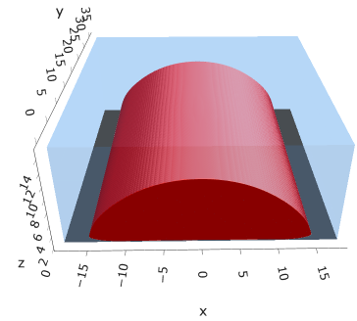
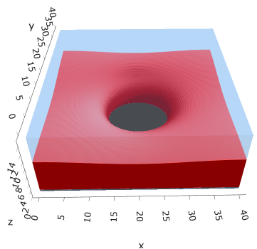
a05s5e3
F = -2.97424
F = -2.97274

Slide 5



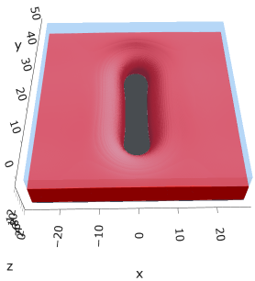

a10s5e3 - DONE
F = -2.93788
F = -2.93873
F = -2.93788

Slide 6

a20s022
F = -12.3419

Slide 7
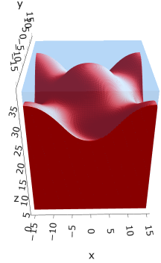
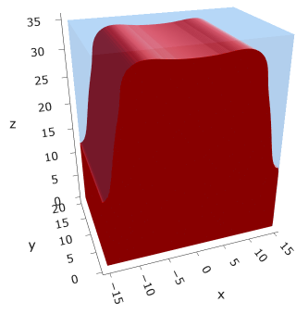

a20s025
F = -14.0011
F = -13.9856
F = -13.9750

Slide 8
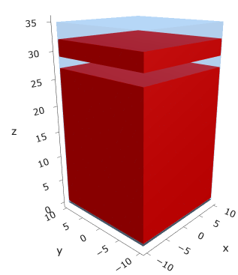

a20s027
F = -15.1048
Note: 2C isomin = 0.50 (temp?)

Slide 9
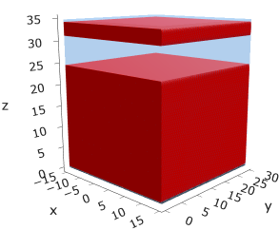
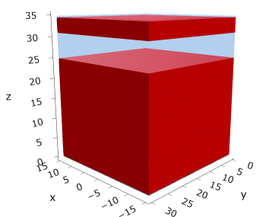
a25
s15
s18

Slide 10





a35
s10
s12
s15
s18

Slide 11



Parallelization
$$α=0, χ=1.25, N=50, σ=0.02$$
$$α=0, χ=1.25, N=200, σ=0.005$$
$$L_{x}=L_{y}=23, { L}_{z}=15$$
Nth = 12: 500 it, 4.3 hrs
Nth = 8 : 500 it, 6.9 hrs
Nth = 6 : 415 it, 20 hrs (poss. mem bottleneck)

Slide 12







Exercise: Micelle / Stripe
s = 5e-03, N = 50, a = 0.0, x = 1.0
s = 5e-03, N = 75, a = 0.0, x = 1.0
Isosurface at pha = 0.1

Slide 13






a040x170s020

Slide 14






a040x170s010

Slide 15

a040x170s025

Slide 16














a040x170s022

Slide 17










a040x170 seed
See if becomes hex
cyl4-975
cyl4-12
cyl16-975
cyl16-1025
cyl1

Slide 18






a040x170s017

Slide 19












































a040x170s015 seed
Almost done
Almost done

Slide 20

















a040x170s013

Slide 21
















a040x170s010 seed

Slide 22














X200 x170 x130 x120 x100
F = −10.24458
F = − 9.14301
F = −11.0057
F = −10.2429
F = −11.0015
F = −9.63949
F = −10.2461
F = −10.9948
F = − 9.63030
F = −10.2431
F = −10.9953

Slide 23





a040x100 relaxation

Slide 24








































a040x100 seed
old
old

Slide 25


a040x120 relaxation
F = −10.24458

Slide 26





































a040x120 seed
cyl16-850
cyl16-825

Slide 27






a040x130 relaxation

Slide 28




a040x170 relaxation
F = −9.10347
1 neck

Slide 29







a040x200 relaxation

Slide 30










a040x200 seed
Note: not completely converged but stopped for resources

Slide 32


a0.40 x1.70

Slide 33





Zhulina JCP 1998
a = 0.01
0.1 mM
1 mM
May need to init using sine
10 mM
25 mM
Zhulina NVT; current GCE runs at Lz = 20

Slide 34

Carrillo Langmuir 2009

Slide 35

Parallelization

Slide 36
Equations
Quenched average, np, A --> \inf ; np/A → \sigma
Discrete Gaussian chain

Slide 37




Scaling (Alexander—de Gennes brush)
V = 4.2; H = 27.5 – 30.5
V = 2; H = 39 – 45.5

Slide 38






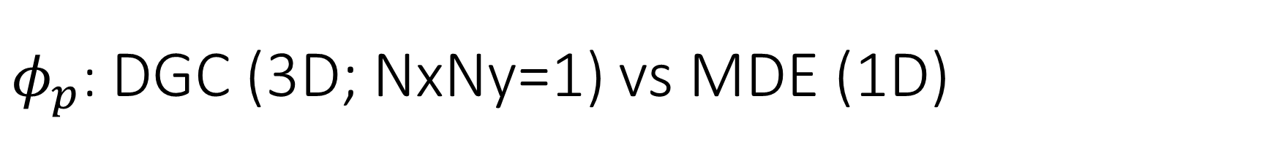
$φ_{p}$: DGC (3D; NxNy=1) vs MDE (1D)
Ns/sigs: dz = 0.10, Ngz_2 = 4$σ$; Chis/bs: dz = 0.25, Ngz_2 = 3.5$σ$

Slide 39


Numericals
Ys
Possibly do Ngz for multiple dzs

Slide 40








3D
Lxy = 1
Lxy = 10
Lxy = 5
Lxy = 15
y-z heatmaps for $φ_{p}$ at constant x

Slide 41





z-FFT vs z-FD (MDE) – REDFT01 xy(z)
Lx = 5, Ly = 5, Lz = 50. s = 0.02. x = 0.75. a = 0.00, N = 50
3D vs 1D (dashed): dz = 0.5, ds = 0.20; dz_1D = 0.113, ds_1D = 0.083
FFT (xyz)
FFT (yz vs pha)
FD (xyz)
FD (yz vs pha)
Diff btw 1D/3D should just be dz, ds, etc.

Slide 42
Specifying Grafted Points

Slide 43
Strategy
2D binary array for surface sites of homogeneously grafted polymer given grafting density, simulation box size, and discretization (and assuming dx = dy)
Fullspace must be periodic on x0 = xL, y0 = yL
Halfspace must be even on xL/2 and yL/2 (overlap of boundary following REDFT00) and periodic on x0 = xL, y0 = yL.
Homogeneous spacing as determined by regular hexagon, where grafting point at centroid of hexagon
In case there are edge effects, try shifting the centroids away from the boundaries of the xy-plane (only did for fullspace)
Make sure no edge effects by comparing results of full FFT with cos FFT

Slide 44
Test conditions
Sigma = 0.05 c/nm2
Lx = 15 nm
Ly = 15 nm
dx = 0.4 nm
Cast in terms of dx (for rounding and PBC for grafting points):
Sigma = 0.0668 c/nm2
Lx = 14.80 nm
Ly = 11.20 nm
(Sigma error decrease with dx)

Slide 45

Padded PBC (Full FFT)
Hexagons drawn for illustration of hexagon approach

Slide 46

Unpadded PBC (Full/Cos FFT)

Slide 47






Other conditions (full and half results overlapped to show match)
s = 0.0241 (20.28%; dx=0.4), Lx, Ly = 12.40, 20.80
s = 0.0208 (4.08%; dx=0.1), Lx, Ly = 12.90, 22.30
s = 0.1332 (11%; dx=0.1), Lx, Ly = 20.50, 20.40

Slide 48


